Slide 1
CS4038
DATA MINING
LECTURE # 16
SPRING 2024
FAST – NUCES, CFD CAMPUS
Ayesha Liaqat
ayesha.liaqat@nu.edu.pk

Slide 2
TODAY’S TOPICS
Decision tree classifier (continued)
Entropy
Misclassification error
Comparison: attribute selection measures
Alternate choices

Slide 3
PRACTICE WORK
categorical
categorical
continuous
class
ID | Home Owner | Marital Status | Annual Income | Defaulted Borrower
1 | Yes | Single | 125K | No
2 | No | Married | 100K | No
3 | No | Single | 70K | No
4 | Yes | Married | 120K | No
5 | No | Divorced | 95K | Yes
6 | No | Married | 60K | No
7 | Yes | Divorced | 220K | No
8 | No | Single | 85K | Yes
9 | No | Married | 75K | No
10 | No | Single | 90K | Yes
Create a decision tree using GINI index and binary splits of attributes.
10

Slide 4
ENTROPY
MEASURE OF IMPURITY

Slide 5


MEASURE OF IMPURITY: ENTROPY
Entropy at a given node 𝒕 :
Where 𝒑_{𝒊} 𝒕 is the probability of class 𝒊 at node 𝒕, and 𝒄 is the total number of classes
Maximum of log₂𝑐 when records are equally distributed among all classes, implying the
least beneficial situation for classification
Minimum of 0 when all records belong to one class, implying most beneficial situation for classification
Entropy based computations are quite similar to the GINI index computations

Slide 6
COMPUTING ENTROPY OF A SINGLE NODE
C1 | 0
C2 | 6
P(C1) = 0/6 = 0 P(C2) = 6/6 = 1
Entropy = – 0 log 0 – 1 log 1 = – 0 – 0 = 0
P(C1) = 1/6 P(C2) = 5/6
Entropy = – (1/6) log₂ (1/6) – (5/6) log₂ (1/6) = 0.65
P(C1) = 2/6 P(C2) = 4/6
Entropy = – (2/6) log₂ (2/6) – (4/6) log₂ (4/6) = 0.92
C1 | 1
C2 | 5
C1 | 2
C2 | 4

Slide 7

COMPUTING INFORMATION GAIN AFTER SPLITTING
Information Gain:
Gain_{info} = Entropy before splitting – Entropy after splitting
𝑘
𝐺𝑎𝑖𝑛 = 𝐸𝑛𝑡𝑟𝑜𝑝𝑦 𝑝 − * ^{𝑛𝑖} 𝐸𝑛𝑡𝑟𝑜𝑝𝑦(𝑖)
𝑖𝑛𝑓𝑜
𝑛
𝑖=1
Parent Node, 𝑝 is split into 𝑘 partitions (children)
𝑛_{𝑖} is number of records in child node 𝑖
Choose the split that achieves most reduction (maximizes GAIN)
Used in the ID3 and C4.5 decision tree algorithms
Information gain is the mutual information between the class variable and the splitting variable

Slide 8
PROBLEM WITH LARGE NUMBER OF PARTITIONS
Node impurity measures tend to prefer splits that result in large number of partitions, each being small but pure
Gender
Car Type
Customer ID
Yes
No
Family
Sports
Luxury
c₁
^{c}20
^{c}10 ^{c}11
C0: 6
C1: 4
C0: 4
C1: 6
C0: 1
C1: 3
C0: 8
C1: 0
C0: 1
C1: 7
C0: 1
C1: 0
...
C0: 1
C1: 0
C0: 0
C1: 1
...
C0: 0
C1: 1
Customer ID has highest the information gain because entropy for all the children is zero.

Slide 9
GAIN RATIO
Entropy and Gini index tend to favor attributes that have a large number of values.
Large number of outcomes may not be desirable, too small values in each partition are not sufficient to make any reliable predictions.
If all values are unique, then a future data will never get any previous value and hence it won’t be useful for us.
Alternatives:
Restrict the test conditions to binary splits only (e.g., in CART algorithm)
Modify the splitting criterion to take into account the number of outcomes produced by the attribute test condition (e.g, C4.5 uses gain ratio).

Slide 10
GAIN RATIO
Gain Ratio:
𝐺𝑎𝑖𝑛
𝑘 _{𝑛}
𝑛
𝐺𝑎𝑖𝑛 𝑅𝑎𝑡𝑖𝑜 = ^{𝑖𝑛𝑓𝑜}
𝑆𝑝𝑙𝑖𝑡 𝐼𝑛𝑓𝑜 = − * ^{𝑖} 𝑙𝑜𝑔₂ ^{𝑖}
𝑆𝑝𝑙𝑖𝑡 𝐼𝑛𝑓𝑜
𝑛 𝑛
𝑖=1
Parent Node, 𝑝 is split into 𝑘 partitions (children)
𝑛_{𝑖} is number of records in child node 𝑖
Adjusts Information Gain by the entropy of the partitioning (𝑆𝑝𝑙𝑖𝑡 𝐼𝑛𝑓𝑜).
Higher entropy partitioning (large number of small partitions) is penalized!
Used in C4.5 algorithm
Designed to overcome the disadvantage of Information Gain

Slide 11
GAIN RATIO
Gain Ratio:
𝐺𝑎𝑖𝑛
𝑘
𝑛
𝑛
𝐺𝑎𝑖𝑛 𝑅𝑎𝑡𝑖𝑜 =
𝑖𝑛𝑓𝑜
𝑆𝑝𝑙𝑖𝑡 𝐼𝑛𝑓𝑜
𝑆𝑝𝑙𝑖𝑡 𝐼𝑛𝑓𝑜 = − * ^{𝑖} 𝑙𝑜𝑔₂ ^{𝑖}
𝑛
𝑛
Parent Node, 𝑝 is split into 𝑘 partitions (children)
𝑛_{𝑖} is number of records in child node 𝑖
𝑖=1
 | CarType
 | Family | Sports | Luxury
C1 | 1 | 8 | 1
C2 | 3 | 0 | 7
Gini | 0.163
 | CarType
 | {Sports, Luxury} | {Family}
C1 | 9 | 1
C2 | 7 | 3
Gini | 0.468
 | CarType
 | {Sports} | {Family, Luxury}
C1 | 8 | 2
C2 | 0 | 10
Gini | 0.167
SplitINFO = 1.52 SplitINFO = 0.72
SplitINFO = 0.97
Compute the Gain ratio yourself.
Attribute with the maximum Gain Ratio is selected as the splitting attribute.
11

Slide 12
MISCLASSIFICATION ERROR
MEASURE OF IMPURITY

Slide 13



MEASURE OF IMPURITY: CLASSIFICATION ERROR
Classification error at a node 𝑡 :
𝐸𝑟𝑟𝑜𝑟 𝑡 = 1 − max[𝑝_{𝑖} 𝑡 ]
𝑖
Where 𝒑_{𝒊} 𝒕 is the frequency of class 𝒊 at node 𝒕
Maximum of 1 − 1/𝑐 when records are equally distributed among all classes, implying the least interesting situation
Minimum of 0 when all records belong to one class, implying the most interesting situation

Slide 14


𝐸𝑟𝑟𝑜𝑟 𝑡
COMPUTING ERROR OF A SINGLE NODE
= 1 − max[𝑝_{𝑖} 𝑡 ]
𝑖
P(C1) = 0/6 = 0 P(C2) = 6/6 = 1
Error = 1 – max (0, 1) = 1 – 1 = 0
P(C1) = 1/6 P(C2) = 5/6
Error = 1 – max (1/6, 5/6) = 1 – 5/6 = 1/6
P(C1) = 2/6 P(C2) = 4/6
Error = 1 – max (2/6, 4/6) = 1 – 4/6 = 1/3
C1 | 0
C2 | 6
C1 | 1
C2 | 5
C1 | 2
C2 | 4

Slide 15
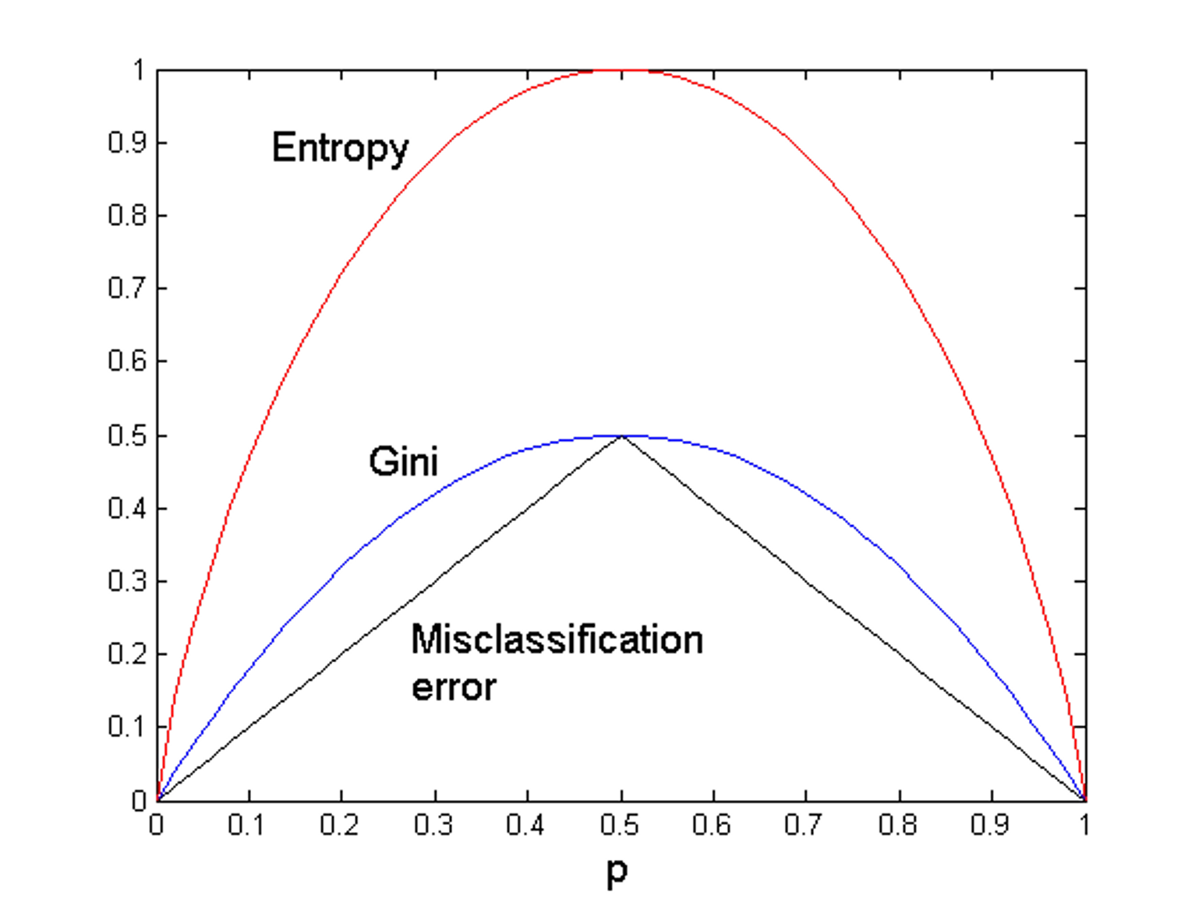
COMPARISON AMONG IMPURITY MEASURES
For a 2-class problem:

Slide 16
MISCLASSIFICATION ERROR VS GINI INDEX
A?
 | Parent
C1 | 7
C2 | 3
Gini = 0.42
Yes
No
Node N1
Node N2
Gini(N1)
= 1 – (3/3)² – (0/3)²
= 0
Gini(N2)
= 1 – (4/7)² – (3/7)²
= 0.489
Gini(Children)
= 3/10 * 0 + 7/10 * 0.489
= 0.342
 | N1 | N2
C1 | 3 | 4
C2 | 0 | 3
Gini=0.342
Misclassification error for all three cases = 0.3 !
Gini improves but error remains the same!!

Slide 17
DECISION TREE INDUCTION
How are decision trees used for classification?
Given an instance, X, for which the associated class label is unknown,
The attribute values of the instance are tested against the decision tree
A path is traced from the root to a leaf node, which holds the class prediction for that instance.

Slide 18
ALGORITHM FOR DECISION TREE INDUCTION
Basic algorithm (a greedy algorithm)
Tree is constructed in a top-down recursive divide-and-conquer manner
At start, all the training examples are at the root
Attributes are categorical (if continuous-valued, they are discretized in advance)
Examples are partitioned recursively based on selected attributes
Test attributes are selected on the basis of a heuristic or statistical measure (e.g., information gain)
Conditions for stopping partitioning
All samples for a given node belong to the same class
There are no remaining attributes for further partitioning – majority voting is employed for classifying the leaf
There are no samples left

Slide 19
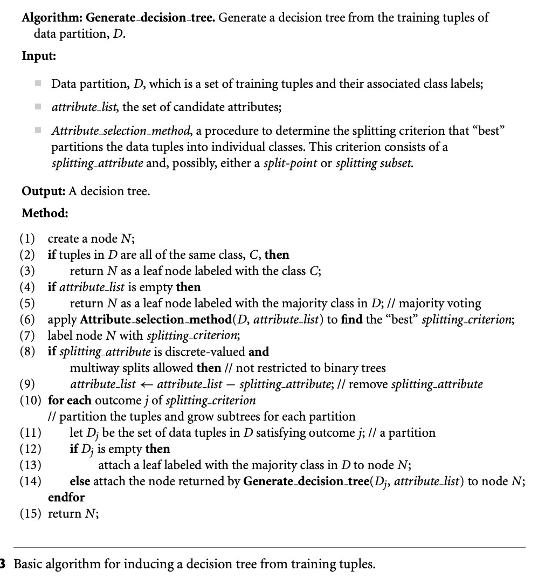
DT ALGORITHM

Slide 20
DECISION TREE BASED CLASSIFICATION
Advantages:
Relatively inexpensive to construct
Extremely fast at classifying unknown records
Easy to interpret for small-sized trees
Robust to noise (especially when methods to avoid overfitting are employed)
Can easily handle redundant attributes
Can easily handle irrelevant attributes (unless the attributes are interacting)
Disadvantages: .
Due to the greedy nature of splitting criterion, interacting attributes (that can distinguish between classes together but not individually) may be passed over in favor of other attributes that are less discriminating.
Each decision boundary involves only a single attribute
Notes:
1)Implemented with array/linked list, less preprocessing, greedy so does not consider future splits so easy.
4)Limited Depth and pruning avoid noise
5) Pruning is done so redundant attr branches are removed as they do not improve prediction
Disadv:
e.g… the heart condition of a patient with Age and Blood Pressure.

Slide 21
COMPARING ATTRIBUTE SELECTION MEASURES
The three measures, in general, return good results but
Information gain:
biased towards multivalued attributes
Gain ratio:
tends to prefer unbalanced splits in which one partition is much smaller than the others
Gini index:
biased to multivalued attributes
has difficulty when # of classes is large
tends to favor tests that result in equal-sized partitions and purity in both partitions

Slide 22
OTHER ATTRIBUTE SELECTION MEASURES
CHAID: a popular decision tree algorithm, measure based on χ² test for independence
C-SEP: performs better than info. gain and gini index in certain cases
G-statistic: has a close approximation to χ² distribution
MDL (Minimal Description Length) principle (i.e., the simplest solution is preferred):
The best tree as the one that requires the fewest # of bits to both (1) encode the tree, and
(2) encode the exceptions to the tree
Multivariate splits (partition based on multiple variable combinations)
CART: finds multivariate splits based on a linear combination of attributes

Slide 23
ATTRIBUTE SELECTION MEASURES
Which attribute selection measure is the best?
All measures have some bias.
Most give good results, none is significantly superior than others
It has been shown that the time complexity of decision tree induction generally increases exponentially with tree height.
Hence, measures that tend to produce shallower trees may be preferred.
e.g., with multiway rather than binary splits, and that favor more balanced splits

Slide 24
CHARACTERISTICS OF DECISION TREE INDUCTION
Decision tree induction is a nonparametric approach for building classification models.
Finding an optimal decision tree is an NP-complete problem. Many decision tree algorithms employ a heuristic-based approach to guide their search.
Techniques developed for constructing decision trees are computationally inexpensive (even for large data set).
Accuracies of the trees are also comparable to other classification techniques for many simple data sets.

Slide 25
CHARACTERISTICS OF DECISION TREE INDUCTION
Decision tree algorithms are quite robust to the presence of noise.
The presence of redundant attributes does not adversely affect the accuracy of decision trees.
Since most decision tree algorithms employ a top-down, recursive partitioning approach, the number of records becomes smaller as we traverse down the tree. This can lead to data fragmentation problem.
A subtree can be replicated multiple times in a decision tree.
Notes:
Loss of global insight, potential inconsistencies in decision making across fragments

Slide 26
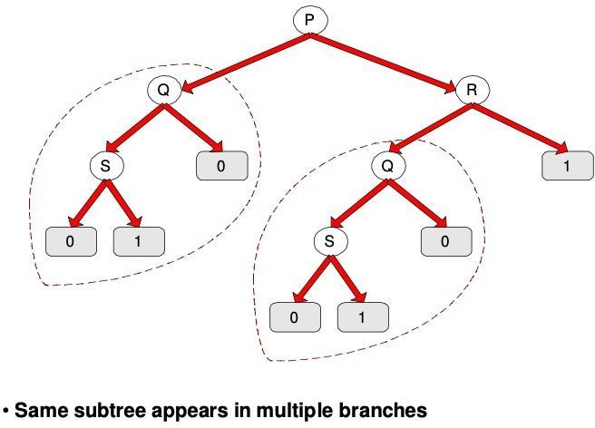
TREE REPLICATION

Slide 27
CHARACTERISTICS OF DECISION TREE INDUCTION
The test conditions described so far involve using only a single attribute at a time. Hence, the attribute space is partitioned into disjoint regions (known as decision boundary) until each region contains records of the same class.

Slide 28
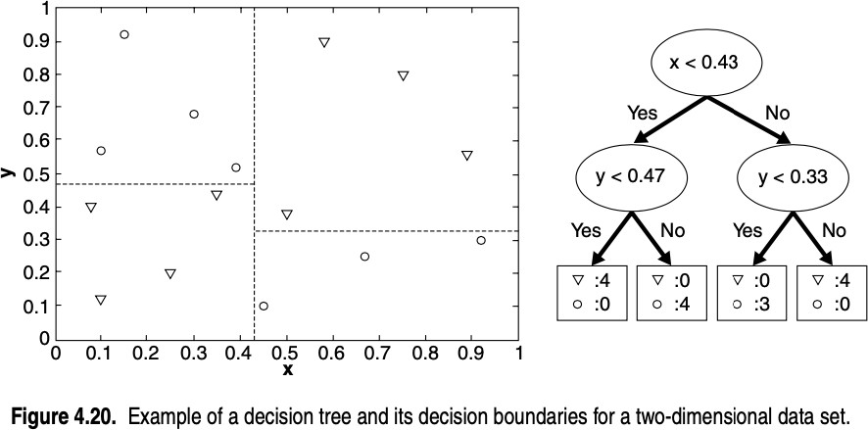
DECISION TREE BOUNDARY EXAMPLE
Border line between two neighboring regions of different classes is known as decision boundary.
Decision boundary is parallel to axes because test condition involves a single attribute at-a-time.

Slide 29
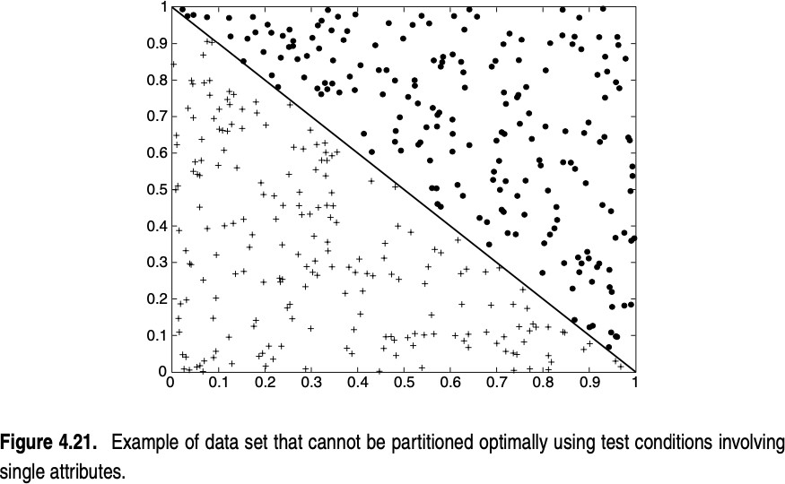
DECISION TREE SINGLE ATTRIBUTE TEST PROBLEM

Slide 30
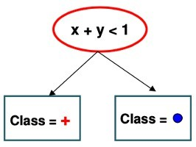
SOLUTION: OBLIQUE DECISION TREES
Test condition may involve multiple attributes. More expressive representation.
Finding optimal test condition is computationally expensive

Slide 31
ALTERNATIVE SOLUTION
Constructive induction provides another way to partition the data into homogeneous, nonrectangular regions.
Creates composite attributes representing an arithmetic or logical combination of the existing attributes.
The new attributes provide a better discrimination of the classes and are augmented to the data set prior to decision tree induction.
Constructive induction is less expensive because it identifies all the relevant combinations of attributes once, prior to constructing the decision tree.
Notes:
Capture r/p between varaibles

Slide 32
CHARACTERISTICS OF DECISION TREE INDUCTION
Studies have shown that the choice of impurity measure has little effect on the performance of decision tree induction algorithms.
Impurity measures are quite consistent.
The strategy used to prune the tree has a greater impact on the final tree than the choice of impurity measure.
Notes:
Across Various datasets and scenarios

Slide 33
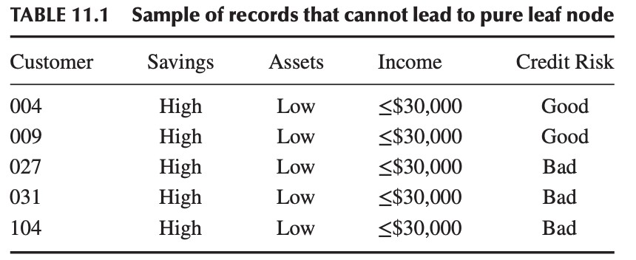
CHARACTERISTICS OF DECISION TREE INDUCTION
There could be a scenario when a particular node contains “diverse” attributes, and yet the decision tree cannot make a split.
Leaf nodes will contain mixed values for the target attribute.
For example:
The decision tree may report that the classification for such customers is “bad,” with 60% confidence.

Slide 34
ENHANCEMENTS TO BASIC DECISION TREE INDUCTION
Allow for continuous-valued attributes
Dynamically define new discrete-valued attributes that partition the continuous attribute value into a discrete set of intervals
Handle missing attribute values
Assign the most common value of the attribute
Assign probability to each of the possible values
Attribute construction
Create new attributes based on existing ones that are sparsely represented
This reduces fragmentation, repetition, and replication

Slide 35
DECISION TREE VARIANTS
ID3 (Iterative Dichotomiser) algorithm
Developed by J. Ross Quinlan
During the late 1970s and early 1980s
C4.5 algorithm
Quinlan later presented C4.5 (a successor of ID3)
Became a benchmark to which newer supervised learning algorithms are often compared.
Commercial successor: C5.0
CART (Classification And Regression Trees) algorithm
The generation of binary decision trees
Developed by a group of statisticians

Slide 36
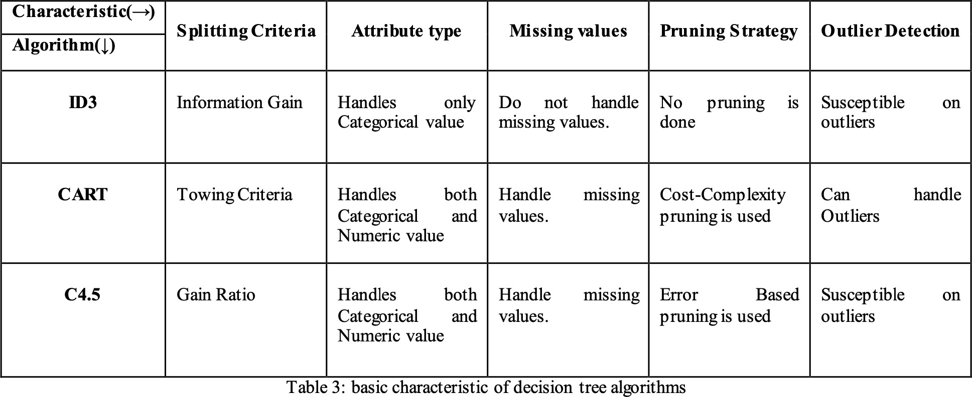
ID3 VS. CART VS. C4.5
or Gini Index
Reference: Singh, S., & Gupta, P. (2014). Comparative study ID3, cart and C4. 5 decision tree algorithm: a survey. International Journal of Advanced Information Science and Technology (IJAIST), 27(27), 97-103.

Slide 37
OVERFITTING AND TREE PRUNING
Overfitting: An induced tree may overfit the training data
Too many branches, some may reflect anomalies due to noise or outliers
Poor accuracy for unseen samples
Two approaches to avoid overfitting
Prepruning: Halt tree construction early ̵ do not split a node if this would result in the goodness measure falling below a threshold
Difficult to choose an appropriate threshold
Postpruning: Remove branches from a “fully grown” tree—get a sequence of progressively pruned trees
Use a set of data different from the training data to decide which is the “best pruned tree”
Notes:
Max depth, min samples per leaf, cross validation.

Slide 38
READING MATERIAL
Chapter 4:Tan, Steinbach & Kumar
Chapter 8: Han, Kamber & Pei
Articles on Decision Tree and variants: https://www.softwaretestinghelp.com/decision-tree-algorithm-examples-data-mining/
https://www.kdnuggets.com/2020/01/decision-tree-algorithm-explained.html
An article on: Information Theory – Rational behind using logarithm in entropy
https://randompearls.com/science-and-technology/mathematics/information-theory- rationale-behind-using-logarithm-entropy-and-other-explanations/?s=ms

